Slide 1
Optimization (Casadi)

Slide 2
Casadi-LP Example
Subject to
where

Slide 3
QP example
Subject to
where
Q=DM([[100,0],[0,200]])
Qx=mtimes(Q, x)
f1=mtimes(c.T, x)+mtimes(x.T,Qx)

Slide 4
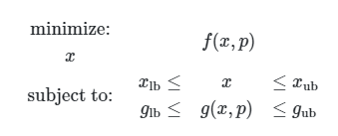
Nonlinear Programming NLP

Slide 5



Slide 6
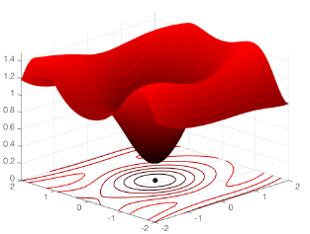

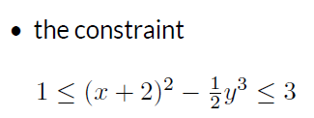
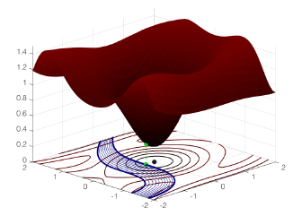
Example 3

Slide 7

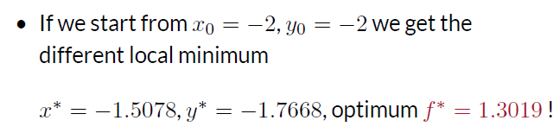

Slide 8
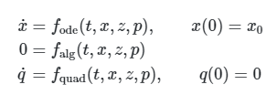

Integration
Differential algebraic equation
Example 1

Slide 9
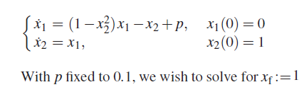
Example 2

Slide 10
Integration
Differential algebraic equation
MX –matrix valued operations
x = SX.sym('x'); z = SX.sym('z'); p = SX.sym('p')
dae = {'x':x, 'z':z, 'p':p, 'ode':z+p, 'alg':z*cos(z)-x}
F = integrator('F', 'idas', dae)
print(F)
idas: Implicit Differential algebraic solver
r = F(x0=0, z0=0, p=0.1)
print(r['xf'])

Slide 11
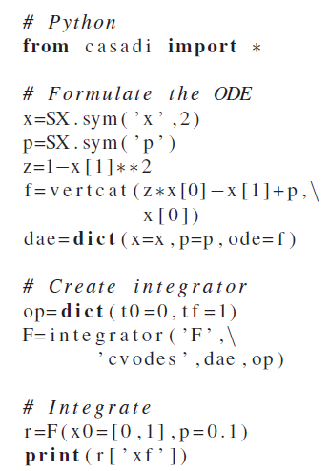

Slide 12
a=SX.sym('a')
b=SX.sym('b')
sum1=a+b
prod1=a*b
F1 = Function('F1', [a,b], [sum1, prod1],['a','b'],['sx','xp'])
s1=F1(a=2,b=3)
list[<start>:<stop>:<step>]
print(s1['sx'].full())
a = '1234'
a[::-1]
[[5.]]
'4321'

Slide 13
from casadi import *
x = SX.sym( 'x' , 2)
A = SX.sym( 'A', 2 , 2)
e = mtimes(A, sin(x
print(e)
r=SX.sym('r')
V=4/3*pi*r**3
#Derivative of V
A=jacobian(V,r)
#Define function f(r)=A
f=Function('f',[r],[A])
f(2)
# Solve the problem
r=F(x0=[2.5,3.0])
print(r['x'])
x = SX.sym( 'x')
y = SX.sym( 'y')
z=y-(1-x)**2
f=x**2+100*z**2
P=dict(x=vertcat(x,y),f=f)
# Create solver instance
F=nlpsol('F','ipopt',P)

Slide 14
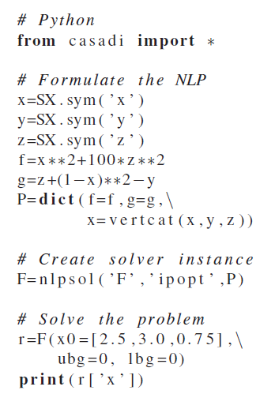

Slide 15
Casadi-LP Example
Subject to
where

Slide 16
c=DM([-7000,-6000]) # Objective function coeffs
A=DM([[4000,3000],[60,80]]) # Constraints lhs
b=DM([100000,2000]) # Constraint rhs
lb=[0,0] # Lower bounds on x
ub=[inf,inf] # Upper bounds on x
x=SX.sym('x',2) # Create symbolic variable
e =mtimes(A, x)-b
f1=mtimes(c.T, x)
prob_struct = dict(x = x, f=f1, g=e)
solver = qpsol('solver','qpoases',prob_struct)
sol=solver(x0=[1,1],lbg=[-inf,-inf],ubg=[0,0],lbx=lb,ubx=ub)
sol['x'] #optimal solution
sol['f'] # Objective function value
float(sol['f'])

Slide 17
QP example
Subject to
where
Q=DM([[100,0],[0,200]])
Qx=mtimes(Q, x)
f1=mtimes(c.T, x)+mtimes(x.T,Qx)

Slide 18
Nonlinear Programming NLP

Slide 19
Example 1
param=[] # there are no parameter in this optimization problem
args = dict(x0=5, # initial guess
lbx=-float("inf"),
ubx=float("inf"),
lbg=-float("inf"),
ubg=float("inf"),
lam_x0=0,
lam_g0=0,
p=param)
# solve the problem
#r=F(x0=5)
sol = F(**args)
from casadi import *
x=SX.sym('w')
obj=x**2-6*x+13
q=[]
P=[]
OPT_variables=x
nlp_prob =dict(f=obj, x=OPT_variables,g=q,p=P)
# ipopt is the solver
options = {
'ipopt.max_iter' : 100,
'ipopt.print_level' : 0,
'ipopt.tol' : 1e-8,
'ipopt.mu_strategy' : 'adaptive',
'print_time' : False,
'verbose' : False,
'expand' : True
}
# Create solver instance
F= nlpsol( 'F' , 'ipopt' , nlp_prob,options )
status = F.stats()['return_status']
print(sol['x']) # Get the solution x

Slide 20

Example 2
x = SX.sym('x'); y = SX.sym('y'); z = SX.sym('z')
nlp = {'x':vertcat(x,y,z), 'f':x**2+100*z**2, 'g':z+(1-x)**2-y}
S = nlpsol('S', 'ipopt', nlp)
print(S)
[2.5,3.0,0.75] as an initial guess, by evaluating the function S
r = S(x0=[2.5,3.0,0.75],\
lbg=0, ubg=0)
x_opt = r['x']
print('x_opt: ', x_opt)

Slide 21
Example 3

Slide 23
Integration
Differential algebraic equation
MX –matrix valued operations
x = SX.sym('x'); z = SX.sym('z'); p = SX.sym('p')
dae = {'x':x, 'z':z, 'p':p, 'ode':z+p, 'alg':z*cos(z)-x}
F = integrator('F', 'idas', dae)
print(F)
r = F(x0=0, z0=0, p=0.1)
print(r['xf'])
idas: Implicit Differential algebraic solver

Slide 24
Example 2
Xk=Fk['xf']
X=np.array(Xk)
import matplotlib.pyplot as plt
plt.plot(X[2,:],X[3,:])
v=MX.sym('v',2) #velocity
p=MX.sym('p',2) #position
theta=MX.sym('theta') #angle of throw
tf=MX.sym('tf') # time of flight
x=vertcat(v,p) # state variable
p=vertcat(theta,tf) #parameter
dv=[0,-9.81] # Differential equation
dp=v
dx=vertcat(dv,dp)*tf
v0=20
prob_struct = dict(x = x, ode=dx, p=p)
import numpy as np
opts=dict(grid=np.linspace(0,3.5,100
F=integrator('F','cvodes',prob_struct,opts)
a=60*np.pi/180
t_final=3
x0=[v0*np.cos(a),v0*np.sin(a),0,1]
Fk= F(x0=x0, p=[a,t_final])

Slide 25
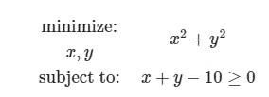
Example 3
x = SX.sym('x'); y = SX.sym('y')
qp = {'x':vertcat(x,y), 'f':x**2+y**2, 'g':x+y-10}
S = qpsol('S', 'qpoases', qp)
print(S)
r = S(x0=[1,3],lbg=0)
r = S(lbg=0)
x_opt = r['x']
print('x_opt: ', x_opt)

Slide 26
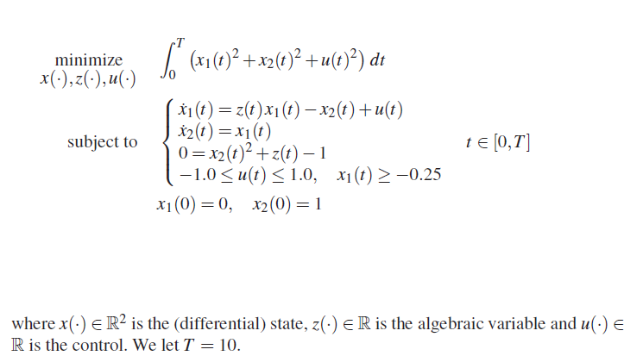
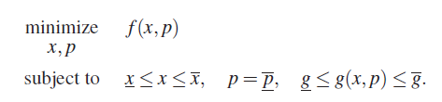
Our goal is to transcribe the Optimal Control problem to the following form

Slide 27

Reformulate the problem from continuous time to discrete time
Differential algebraic equation (DAE)
CVODE solver for stiff and nonstiff ode
idas: Implicit Differential algebraic solver

Slide 28
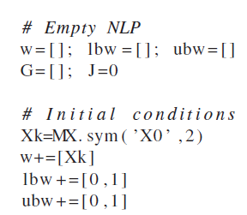
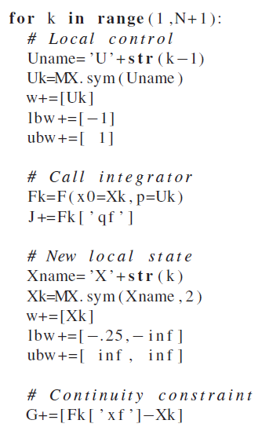
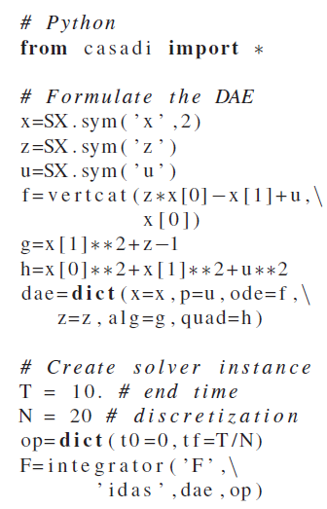


Slide 29
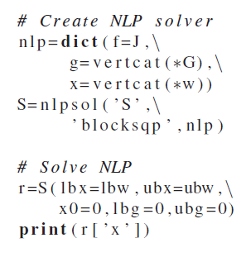

Slide 30
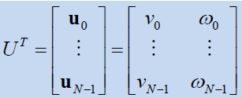
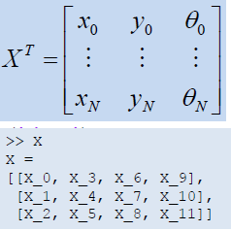

Slide 31
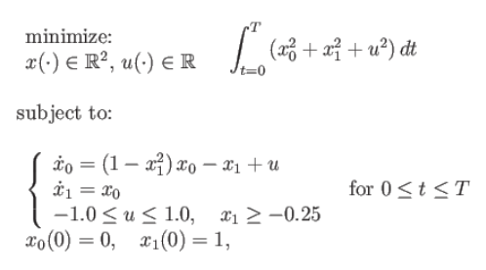

2 1 2
g=
[MX((F(X0, U_0){0}-X_1)),
MX((F(X_1, U_1){0}-X_2)),
MX((F(X_2, U_2){0}-X_3)),
MX((F(X_3, U_3){0}-X_4)),
MX((F(X_4, U_4){0}-X_5)),
MX((F(X_5, U_5){0}-X_6)),
MX((F(X_6, U_6){0}-X_7)),
MX((F(X_7, U_7){0}-X_8)),
MX((F(X_8, U_8){0}-X_9)),
MX((F(X_9, U_9){0}-X_10)),
MX((F(X_10, U_10){0}-X_11)),
MX((F(X_11, U_11){0}-X_12)),
MX((F(X_12, U_12){0}-X_13)),
MX((F(X_13, U_13){0}-X_14)),
MX((F(X_14, U_14){0}-X_15)),
MX((F(X_15, U_15){0}-X_16)),
MX((F(X_16, U_16){0}-X_17)),
MX((F(X_17, U_17){0}-X_18)),
MX((F(X_18, U_18){0}-X_19)),
MX((F(X_19, U_19){0}-X_20))]
20 value
len(lbg)=40
len(ubg)=40
ubg=lbg=0
lbw=
[0,
1,
-1,
-0.25,
-inf,
-1,
-0.25,
-inf,
.
.
.
ubw=
[0,
1,
1,
inf,
inf,
1,
len(ubw)=62
len(lbw)=62
len(w0)=62
discrete autonomous "differential equations"
c=F([0.2,0.3],0.4)[0]-DM([0.2,0.3])
c

Slide 32

w
[X0,
U_0,
X_1,
U_1,
X_2,
U_2,
X_3,
U_3,
X_4,
U_4,
X_5,
U_5,
X_6,
U_6,
X_7,
U_7,
X_8,
U_8,
X_9,
U_9,
X_10,
41
U_10,
X_11,
U_11,
X_12,
U_12,
X_13,
U_13,
X_14,
U_14,
X_15,
U_15,
X_16,
U_16,
X_17,
U_17,
X_18,
U_18,
X_19,
U_19,
X_20]
The prediction x and control action u
Discritization of differential equations

